Slide 1
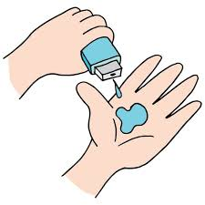
"Healthcare Insights: Analyzing Doctor Visits and Patient Trends"
Name: Bisht Pawan Kalyan
AICTE Internship Student Registration ID :-STU66391279062ef1715016313
College: Thakur College Of Engineering And Technology
Branch: Artificial Intelligence And Data Science
Year: 2024-25

Slide 2

PROBLEM STATEMENT:
The project focuses on analyzing healthcare-related data to identify patterns and insights in doctor visits. Specific problem areas include:
Identifying how illnesses, income, gender, and health status influence doctor visits.
Understanding the impact of health insurance on healthcare access.
Exploring correlations between various health and demographic factors.
Providing actionable insights to improve healthcare services.

Slide 3
Project Description: This project conducts an exploratory data analysis (EDA) on a healthcare dataset. Key steps include: 1.Data Cleaning and Preprocessing: Ensuring the dataset is free of duplicates, missing values, and inconsistencies. 2.Data Analysis: Studying patterns like gender-wise illnesses, activity reduction days, and income's effect on healthcare access. Visualizing relationships, such as health status vs. doctor visits, using heatmaps, bar charts, and correlation matrices. 3.Insights Generation: Highlighting trends and identifying areas where healthcare policies can be improved (e.g., targeting low-income or older populations for insurance benefits). 4.Visualization: Using various plots and heatmaps to make insights intuitive and actionable for stakeholders.

Slide 4

WHO ARE THE END USERS?
The insights derived from this analysis are valuable for:
Government and Policy makers:
To design better healthcare policies and insurance schemes for low-income and elderly populations.
Healthcare Providers:
To improve patient care strategies by understanding health pattern.
Insurance Companies:
To target populations needing specific types of coverage.
Public Health Researchers:
To conduct further studies on illness trends and healthcare usage

Slide 5

Technology Used
The project leverages:
Programming Languages:
Python for data analysis and visualization.
Libraries/Frameworks:
Pandas for data manipulation.
Matplotlib and Seaborn for data visualization.
NumPy for numerical computations.
Tools:
Jupyter Notebook for coding.
Presentation tools like PowerPoint for presenting insights.
Data:
CSV files as the primary data format for input.

Slide 6
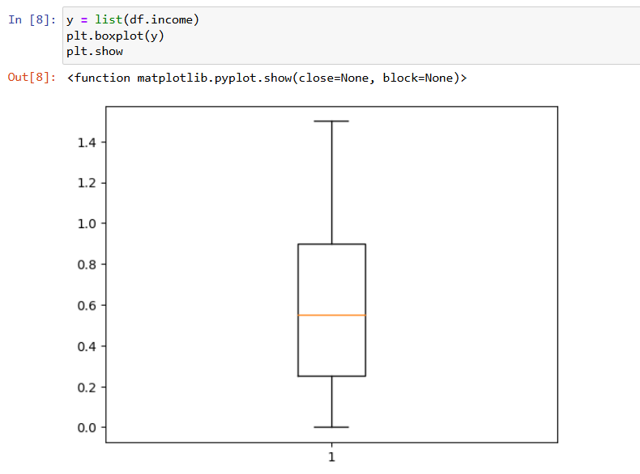
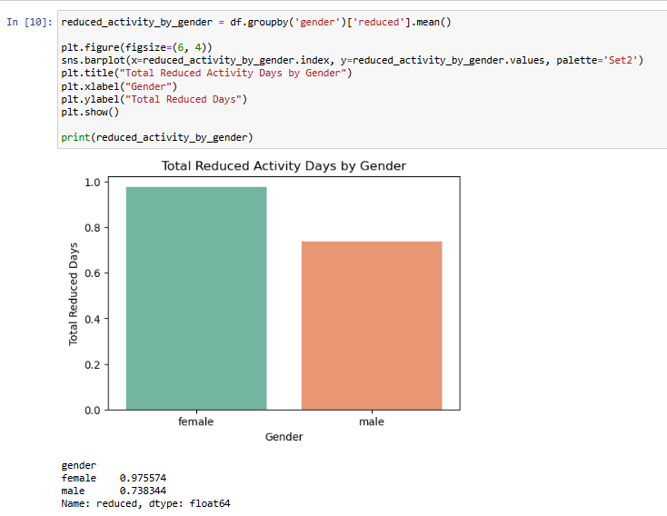
RESULTS:
Demo Link

Slide 7
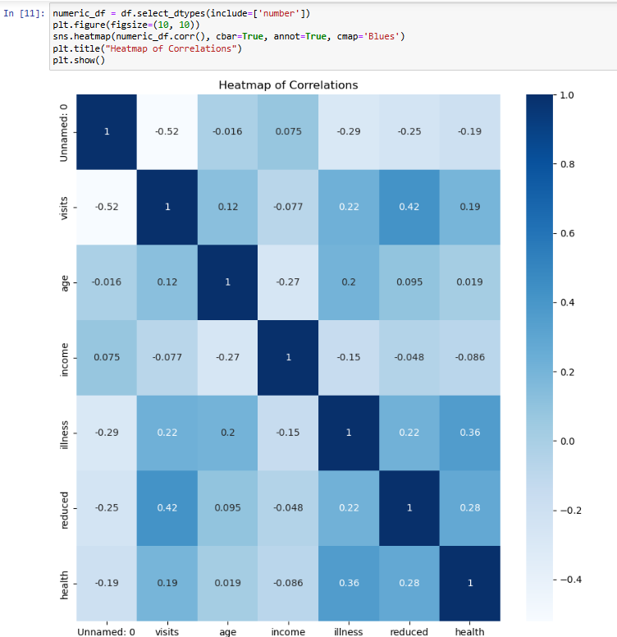
RESULTS:

Slide 8
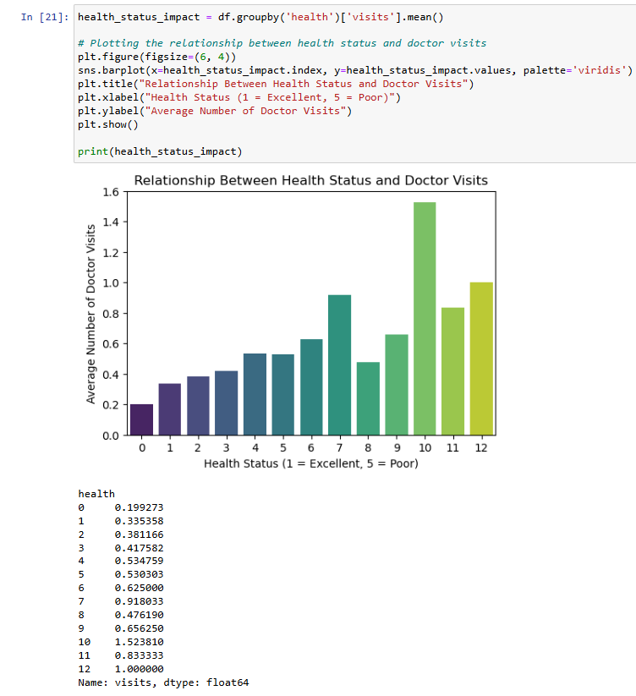
RESULTS:

Slide 9
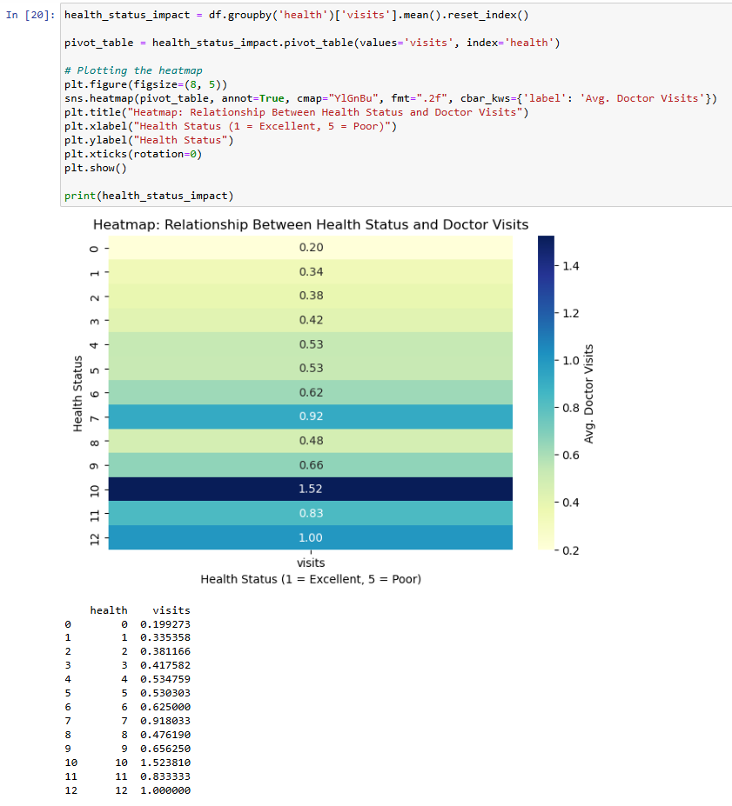
RESULTS:

Slide 10
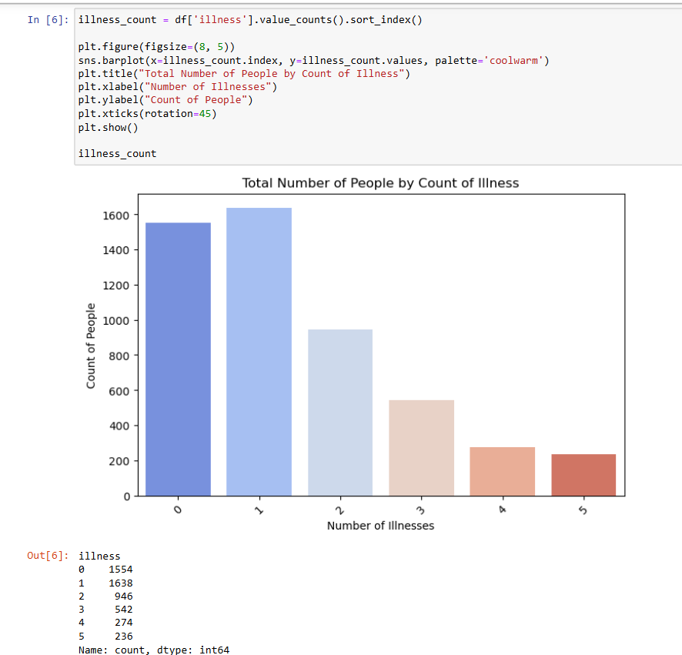
RESULTS:

Slide 11
Thank you
.
.

